Slide 1
From Numbers to Narratives: Exploring Stories Through Interactive Visualisation
Jennifer Wilson (C2885984)
Khinsa Fairuz Zahirah (C2357551)
Richard Agbomire Aviomoh (A0407193)
Georgia Sarmalli (B1509573)

Slide 2
Contents
01. Introduction
02. Project Management
Introduction to our team, and the project context.
Workflow management and reflections on the project.
03. Data Cleaning and Preparation
04. Demonstration of Charts
05. Ethical, Legal and Security Issues
Our data cleaning and preparation processes.
Walkthrough of each chart.
Discussing the ethical, legal and security considerations.

Slide 3




Our team
Fai
Richard
Jen
Georgia

Slide 4
Introducing the Dataset and Project
Context: Kaggle Data Science Survey 2017-2021
Audience: Members of the data science and data analytics community, those aspiring to join or those with an interest in the field.
Aim: To create a set of accessible interactive visualisations that can be used on Kaggle blog posts, LinkedIn and linked to other social media pages
Kaggle Data Science Survey 2017-2021
Notes:
Prompts:
Context – talk briefly about the survey and what it collects / their sample etc
Audience: We can assume some mathematical literacy due to the company / platform.
Aim: Highlight that the focus is creating a series of complimentary charts that form part of a commercial social media presence – not 3 charts that will be used together in one post

Slide 5
The Hidden Thinking
Analysis vs Communication
Context
Audience
Purpose
Design Solutions & Functionality
Representations
Aesthetics
Annotations
Colour
Interactivity
Composition
Chart selection
Inspired by Kirk (2019)
Notes:
Jen – Prompts
The graphic displayed demonstrates the thought process that underpinned our product design and development process. It was inspired by material in Kirk's book.
Because we are producing visualisations that can be used as standalone visualisations within the context of a company's social media, this influenced our decision-making
e.g the charts don't need to tell a sequential story, but need to have enough similarities that they could be put into Kaggle's website and socials without looking incongruent
The focus was communication over analysis, which allowed more 'fun' interactivity without being gimmicky. We wanted the interactions and colour choices to add something to the meaning creations rather than focus purely on aesthetics.

Slide 6
Project Management and Workflow
Dataset selection and preparation
Individual Charts
Select dataset
Clean dataset
Select appropriate features to display
Create individual charts with interactivity.
Chart selection
Presentation
Select appropriate charts to display the data.
Collaborative creation of presentation materials and pitch preparation.

Slide 7
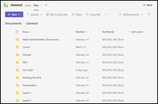
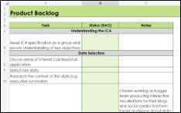
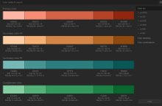
Project Management
All group members have different experiences before the module
Meet weekly with SCRUM-style updates and SMART targets
Use Teams as a shared environment for resources and meeting notes
Aimed to be aware of everyone’s learning and working preferences
Aimed to balance flexibility where required and consistency where needed
Notes:
Supporting scenario - Central data cleansing was done in Excel with group approved changes, but individual processing for charts and EDA for charts was done in whichever platform team members preferred (e.g. PowerBI, Excel, Python).
This allowed us to mirror the workplace where flexibility and professional trust are key.

Slide 8



Data Cleaning and Preparation
Delete Columns
Clean fields
Individual pre-processing and EDA
This allowed the team to have access to the full, clean dataset before specialising in their areas of choice.
Notes:
Georgia:
Main points to cover:
The original dataset had errors and inconsistencies in the column names (e.g. variations on country names)
Some of the columns had a lot of fields and some inconsistencies (e.g. salary had people saying 0-15,000 as well as 0-14,999). We chose to create larger salary bands as part of our group pre-processing to facilitate eda.
Created an agreed set of changes, led by Fai (give some examples)
Each person in the group was responsible for making the required changes in the group's master dataset
Once this was completed and the team have quality assured the master changes, we continued with individual pre-processing specific to our individual charts.

Slide 9


Demonstration of Product
Link to Product Demonstration

Slide 10
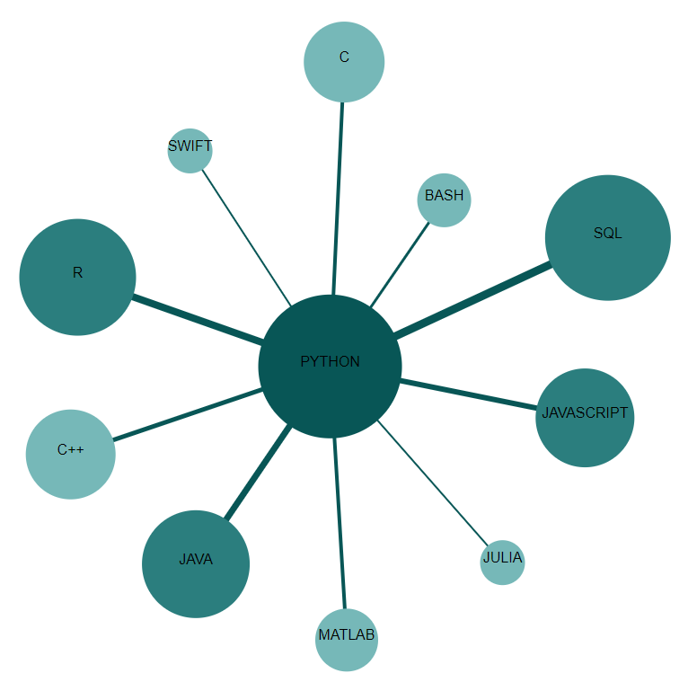
Popular Programming Languages
Chart Choice
Network chart showing the connection between popular programing languages
It provides multiple insights from a single chart, enabling the audience to make more informed decisions.
Design Choices
Python is used as the reference point for the chart and the number of links are reduced to make the chart less ambiguous
Varying the thickness of the links and the size of the nodes based on the number of users. Complementary colors are used for the nodes while contrasting colours are used for the hover effects
Additional Pre-Processing
Removing irrelevant columns, creating new tables for each programming language and deleting empty rows.
Merging columns and creating new tables for each link and filtering the new tables

Slide 11
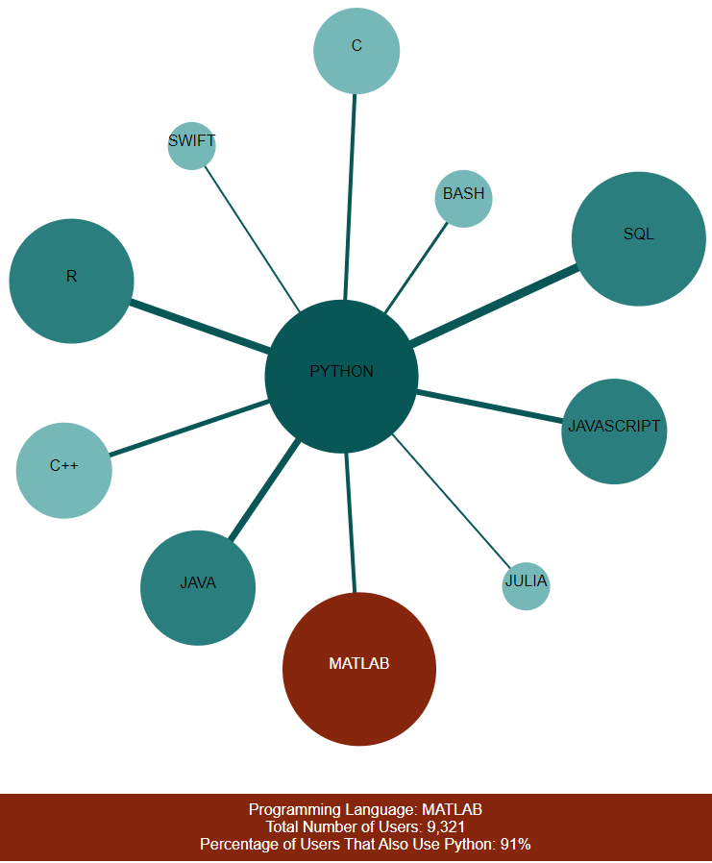
Popular Programming Languages
Functionality
Mobile nodes are designed to enable users move the nodes around making the chart more flexible.
Hover effect on the nodes provides information on the number of users for each language and the percentage of users that also use python.
Hover effect on the links provides information of the percentage of python users that also use another language.
Insight
Python is the most popular language, while SWIFT is the least popular.
Most people that use other languages also use python.
People that use python are more likely to use SQL compared to other languages. Also, very few python users use SWIFT and Julia.
Reflections
Improvement could be made on the hover-effect for the texts in each node
Separate charts could be created to focus on other programing languages

Slide 12
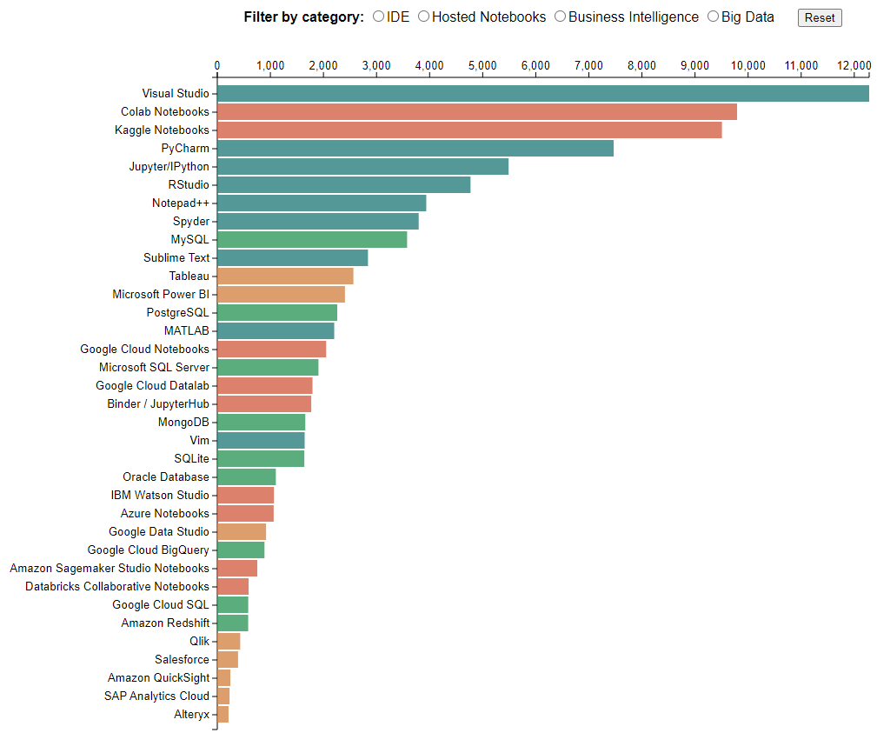
Most Popular Applications
Chart Choice
Horizontal Bar Chart – to compare the most popular applications used by the Kaggle community, providing radio buttons to easily display different categories and a button to reset the chart
Design Choices
Horizontal bars – The labels are long, better to visualise them in a horizontal bar chart
Contrasting colours – To emphasise the different categories
Radio buttons – To help users focus on one application when they need to
Reset button – To help users go back to the initial chart in just one click
Additional Pre-Processing
Selected the appropriate columns
Created pivot tables to summarise the data
Created json file based on the summarised data

Slide 13
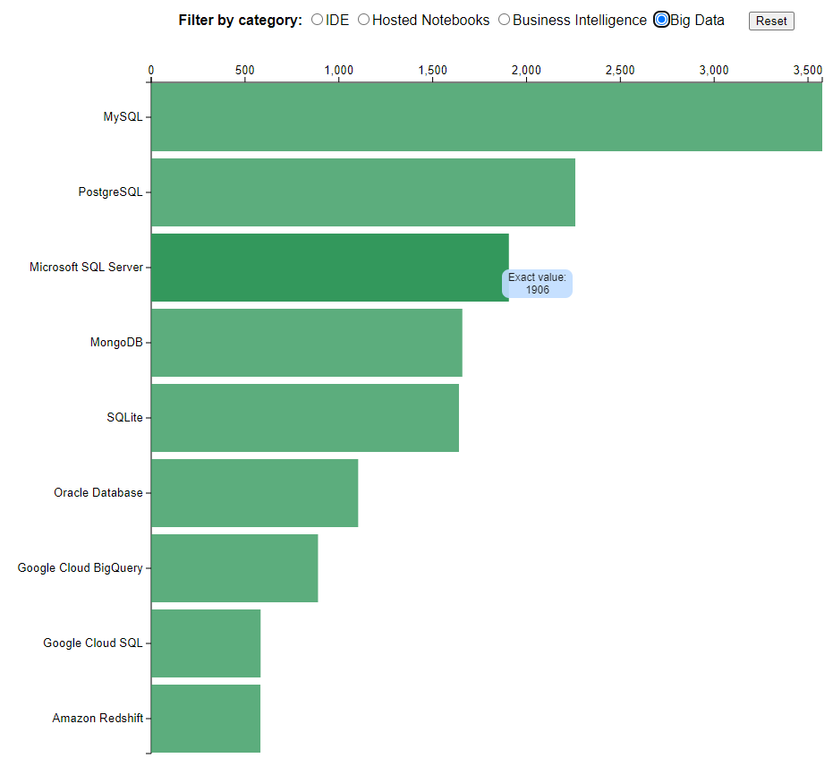
Most Popular Applications
Functionality
The bars are automatically sorted from highest to lowest value
Hovering mouse over each bar shows the exact value
The colour code differentiates each of the categories
Radio buttons are used to filter the data into the desired category
Reset button to reset the chart
Insight
Visual Studio is the most popular IDE application
Colab Notebooks is the most popular Hosted Notebooks application
MySQL is the most popular Business Intelligence application
Tableau is the most popular Big Data application
Reflections
Fitting the data from a hundreds-column excel file to a few hierarchies in json was tedious
Could add a gradient or colour scale based on the values (higher values, darker hues)

Slide 14
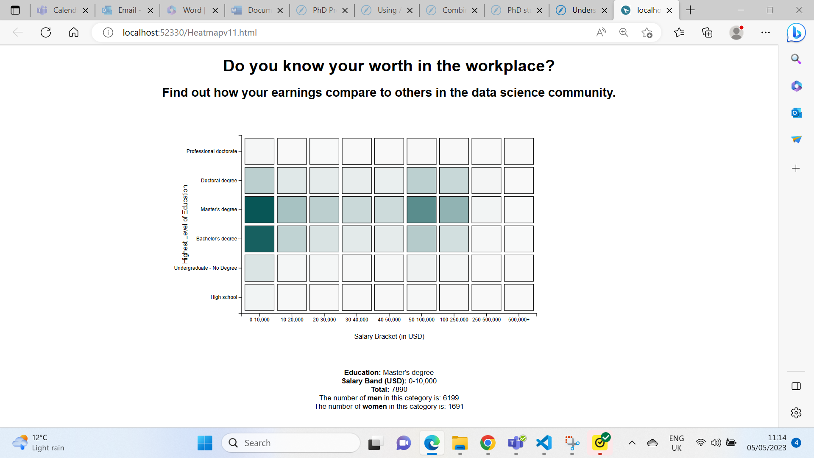
Exploring The Gender Pay Gap
Chart Choice
Heatmap exploring salaries and education level with gender breakdown in the tooltip.
Design Choices
Monochromatic blue from our colour scheme
Light to dark sequential colour scheme to intuitively reflect count of values
Additional Pre-Processing
Sliced 3 variables from the original dataset for 2021
Split the $0-50,000 group into 5 smaller groups
Dropped records that did not respond to the 3 questions chosen
Dropped nonbinary and other gender identities
Notes:
Women in STEM are an under-represented group
Women in society at large are paid less than men
Women (and those who were observed female at birth) are less likely to negotiate their salary at interview, less likely to seek a raise, and less likely to go for promotions unless they tick more criteria than male colleagues (and those observed male at birth).
This chart explores the education and salary distribution of Kaggle respondents and also communicates the breakdown gender within each category, showing women (and those identifying as women) as well as men (and those identifying as men).
References
https://www.stemwomen.com/women-in-stem-percentages-of-women-in-stem-statistics

Slide 15
Exploring The Gender Pay Gap
Functionality
Colour depth reflects higher count within a category
When hovering over a square, a tooltip displays total within the category and gender breakdown.
On mouse leaving, the tooltip stops
Insights
Globally most people in the data science community have a postgraduate degree.
Globally most people earn 0-10,000 USD
Reflections
Being able to add a filter by country and / or age might allow users to have greater insights for their situation whilst maintaining the global nature of the visualisation.
Notes:
Reflections:
ONS statistics suggests nationally the gender pay gap is small for full time employees under the age of 40, but above that the full time gap inceases.
https://www.ons.gov.uk/employmentandlabourmarket/peopleinwork/earningsandworkinghours/bulletins/genderpaygapintheuk/2022
This chart draws on global statistics so having the advanced option to filter by age and / or country might provide more nuanced trends that can help inform individuals in their next career steps.
Kaggle executive summary from 2021 shows that in the US, most data scientists earned 6 figure salaries, whereas in India most earned less than 50,000 https://storage.googleapis.com/kaggle-media/surveys/Kaggle's%20State%20of%20Machine%20Learning%20and%20Data%20Science%202021.pdf

Slide 16
Ethical, legal and security implications
Ethical
Legal
Security
Data is anonymised
Data does not contain personal or sensitive information (name, address, date of birth)
Owned by Kaggle, aggregated by user Andrada (Oleanu, 2021)
Publicly available dataset
Reliable dataset
Originality of the project.
Use of libraries, e.g. d3js
Extensions for MS Visual Studio Code e.g. Open in Default Browser, LiveServer.
Csv files are more secure than JSON
Using online CSV to JSON converters
Notes:
Security:
Using libraries relies on developers keeping the libraries updated. A library such as d3js is likely more secure than other small-scale user created libraries but it's prudent to be aware of the potential issues when using packages and libraries
Extensions are useful applications, but they can have security vulnerabilities. In 2021 Open in Default Browser, commonly used for viewing HTML documents in Visual Studio Code was identified as being vulnerable.
Using online CSV to JSON converters

Slide 17

Thank you
We look forward to taking any questions about our pitch.

Slide 18
References
Gratzl, S. (2020) D3tutorial/barchart06_animation, GitHub. Available at: https://github.com/sgratzl/d3tutorial/blob/main/examples/barchart06_animation.html (Accessed: March 25, 2023).
Holtz, Y. (n.d.). Area Chart | the D3 Graph Gallery. [online] d3-graph-gallery.com. Available at: https://d3-graph-gallery.com/heatmap.
Kaggle (n.d.). State of Data Science and Machine Learning 2021. [online] www.kaggle.com. Available at: https://www.kaggle.com/kaggle-survey-2021.
Kirk, A. (2019). Data visualisation : a handbook for data driven design. Los Angeles: Sage.
Mccandless, D. (2012). Information is beautiful. London: William Collins.
Mccandless, D. (2014). Knowledge is beautiful. New York, Ny: Harper Design, An Imprint Of Harper Collins Publishers.
Olteanu, A. (2021) Kaggle Data Science Survey 2017-2021, Kaggle. Available at: https://www.kaggle.com/datasets/andradaolteanu/kaggle-data-science-survey-20172021 (Accessed: February 14, 2023).

Slide 19
References
Zhuang58 (2021) Tool Network Analysis and Global Distribution, Kaggle. Kaggle. Available at: https://www.kaggle.com/code/zhuang58/tool-network-analysis-and-global-distribution (Accessed: May 8, 2023).
Holtz, Y. (no date) Basic Network chart in d3.js, Basic network graph in d3.js. Available at: https://d3-graph-gallery.com/graph/network_basic.html (Accessed: May 8, 2023).
Triviño, R. (2020) Network graph with D3js on canvas, Medium. Towards Data Science. Available at: https://towardsdatascience.com/network-graph-with-d3js-on-canvas-b90f275dfaa6 (Accessed: May 8, 2023).

